Slide 1
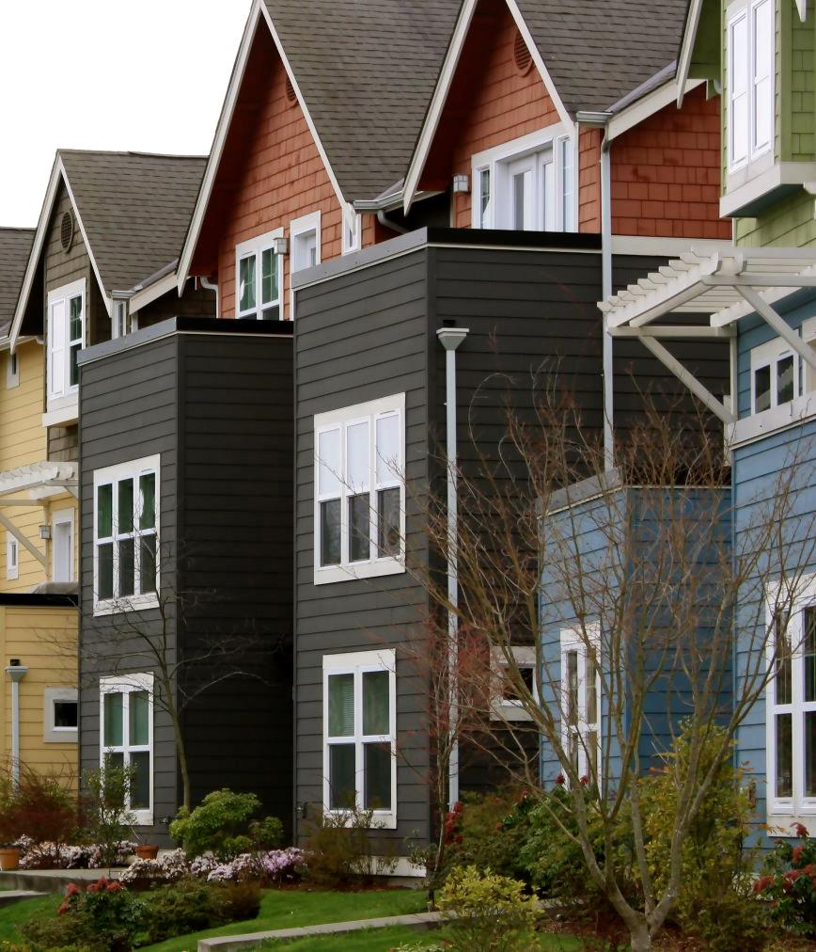
Washington State
Weatherization Plus Health
Michael Furze, Assistant Director
Energy Division
Washington Department of Commerce
12/15/2015

Slide 2
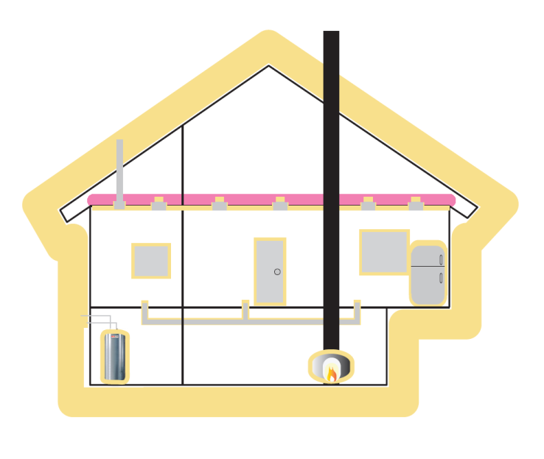
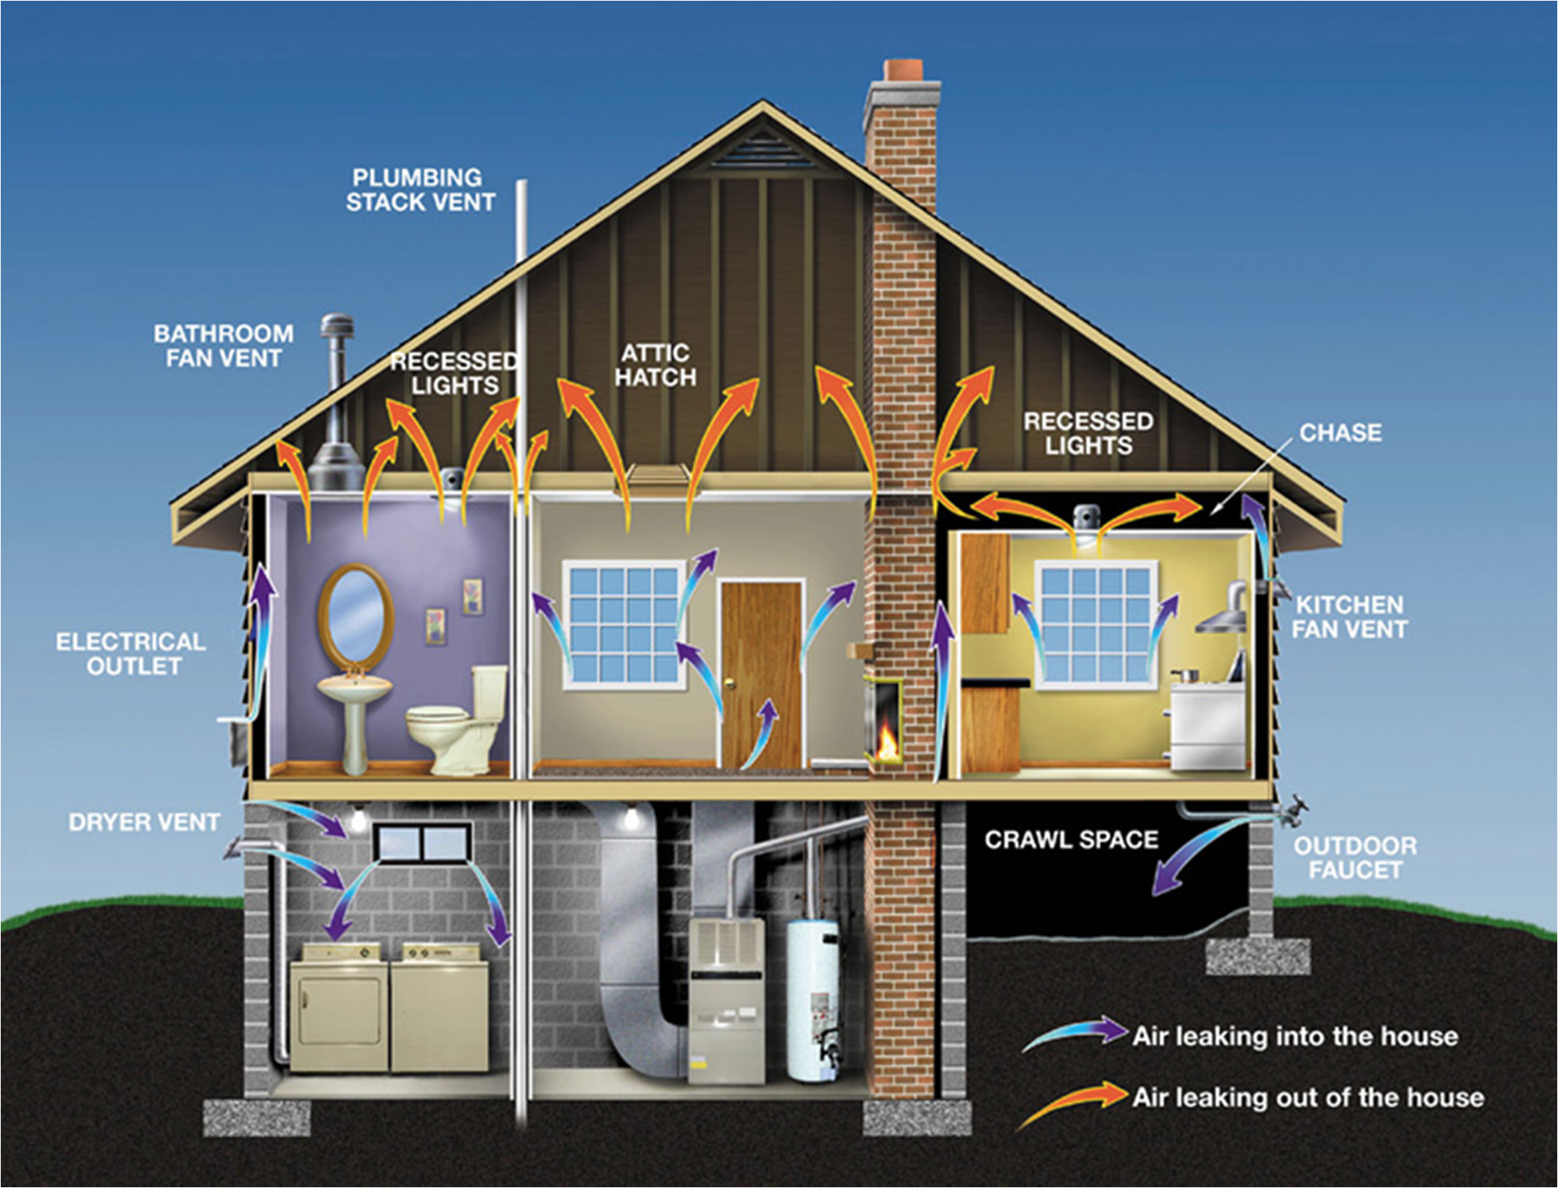
What is Weatherization?
Notes:
Weatherization creates make healthy, efficient homes.
Seal holes to keep warm air in.
Add insulation.
Upgrades mechanical systems.

Slide 3
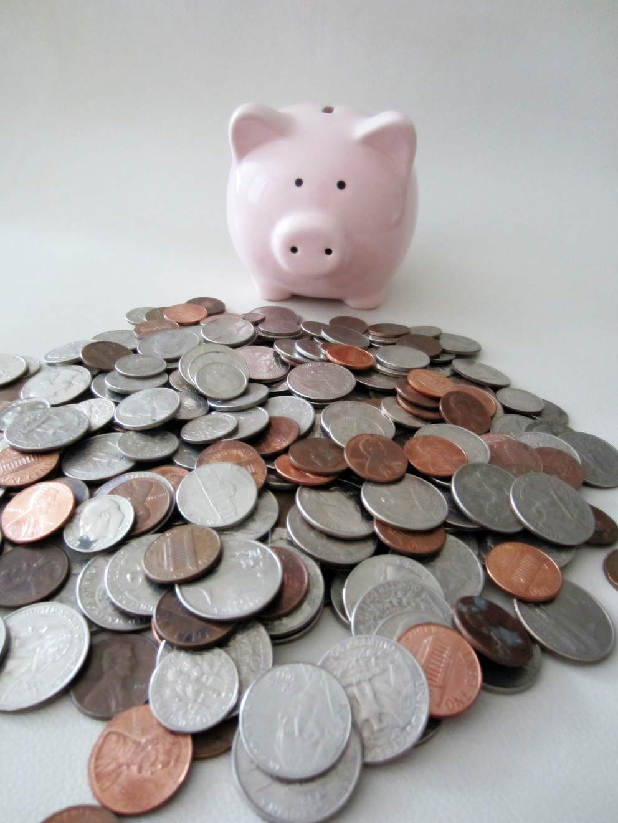
Weatherization’s Goals
Notes:
Right now our job is helping people save money on their power bill, keeping them warm and preserving their housing.

Slide 4
Wx
Health
Notes:
Our program historically addressed energy-related repairs and energy-related health & safety issues.
“Energy-related” are the operative words.

Slide 5
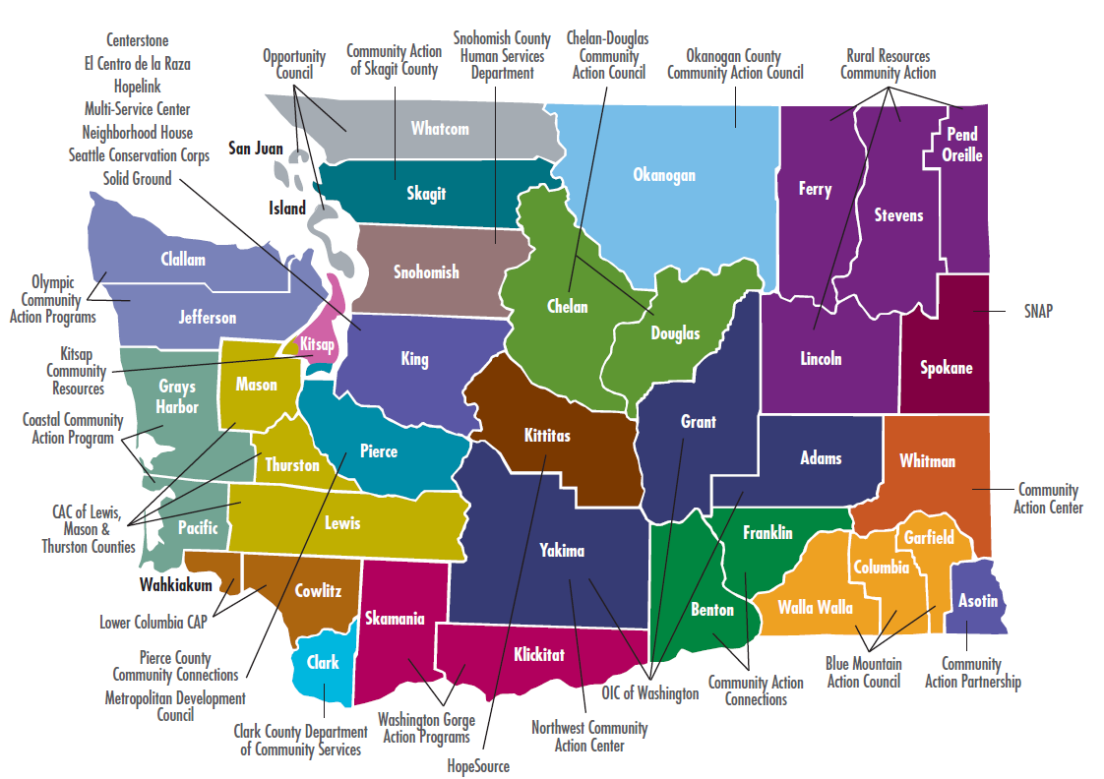
Weatherization’s Service Providers
King County
Housing Authority
Notes:
To deliver our services, we partner with 25 different Community Action Agencies and Local Governments and 3 tribes.

Slide 6
Weatherization’s Funding Partners
Department of Energy
$3.8M
LIHEAP
$11M
Bonneville Power Administration
$2.3
Energy Matchmaker
$7.5M
Utility Funding
$10-12M
Notes:
In Washington, we blend many different funding sources into our program. Federal sources include Bonneville Power Administration, LIHEAP funding through Health & Human Services and the Department of Energy.
We receive state capital funding called Energy Matchmaker.
Commerce partners with some utilities and others partner directly with Local Agencies.

Slide 7
HB 1720: An Act Relating to Healthy Housing
Requires the Department of Commerce to include projects that improve health and safety in the prioritization of funds and to develop policies supporting the health and safety of residents under the Low-Income Residential Weatherization Program.
Authorizes healthy housing improvements for homes undergoing weatherization and defines “healthy housing improvements.”

Slide 8
Weatherization Plus Health Opportunity
Notes:
Before rolling out the program we discussed several approaches with our partners to determine how to quickly and effectively build the statewide program.
We ended up with two pathways forward.

Slide 9
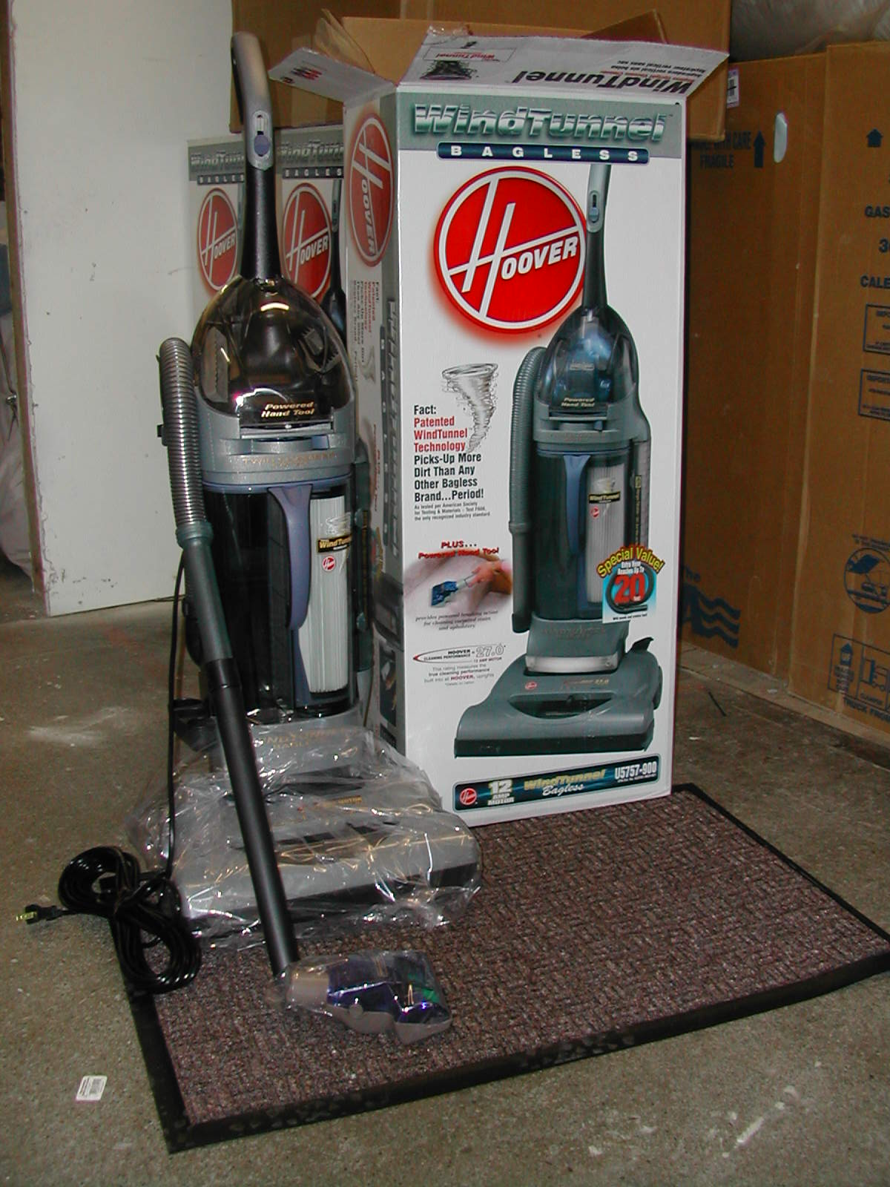
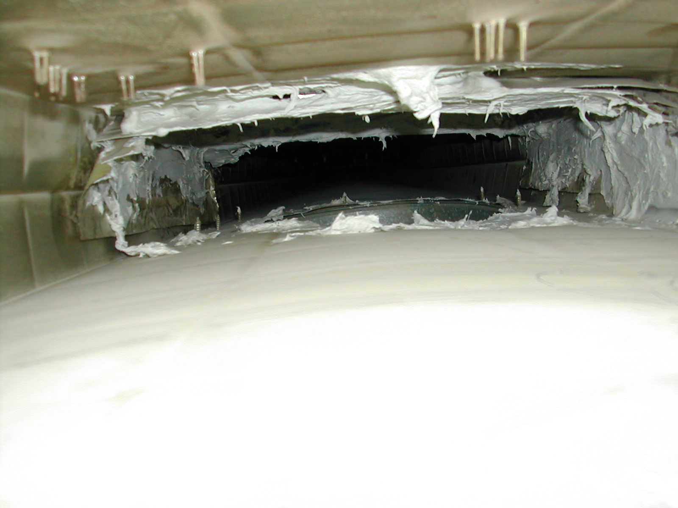
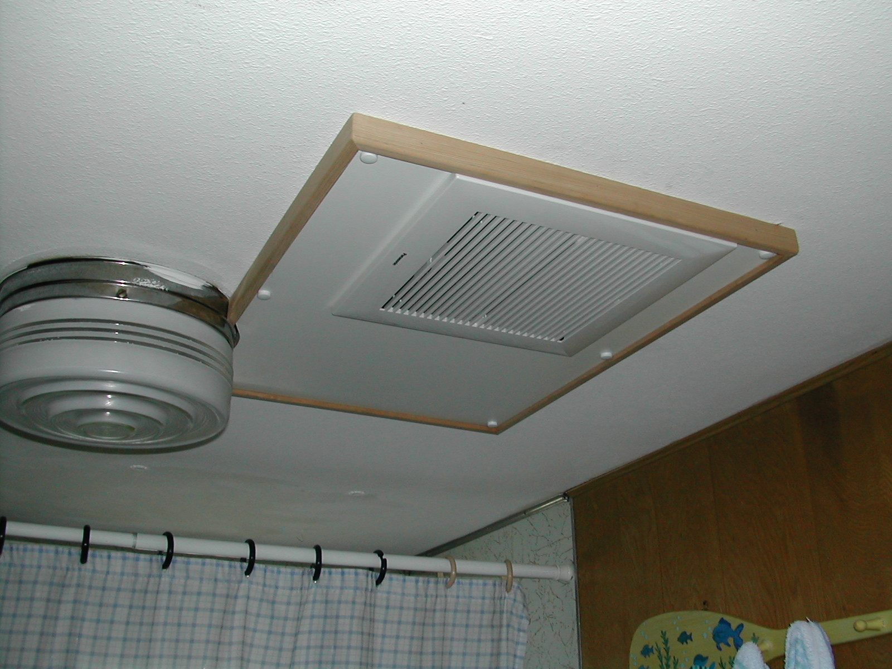
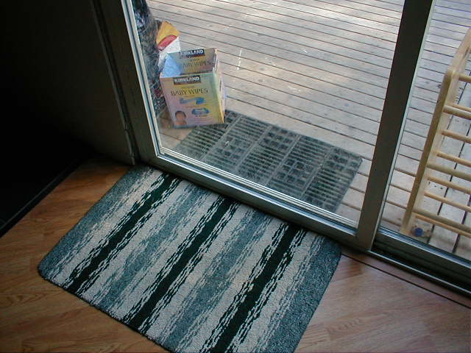
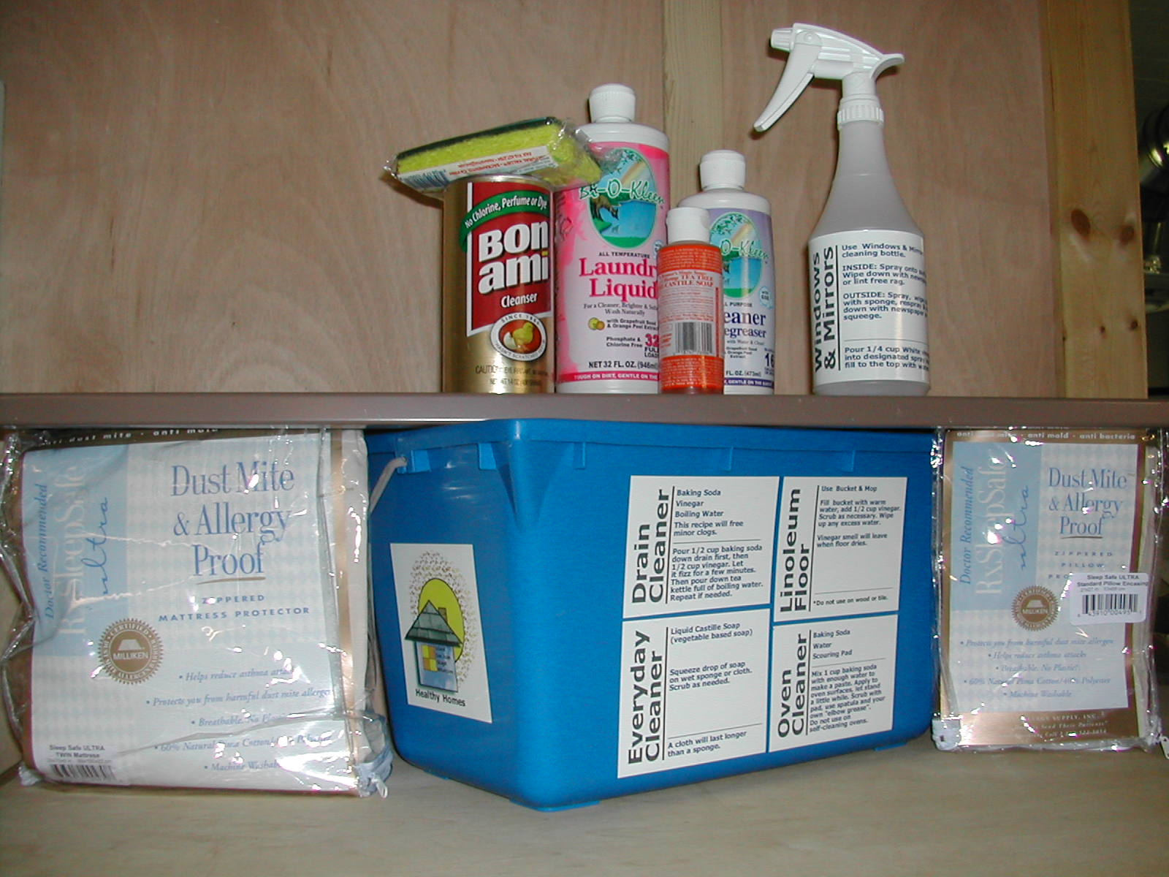
Weatherization Plus Health “Basic”
Notes:
The Wx + H Basic program is available statewide and allows agencies to install a more limited set of measures and provide education.
Pictured:
Hepa vacuum
Rodent exclusion as part of air sealing/Duct system cleaning
Green cleaning kit
Walk off mats
Whole house ventilation system / with outside air supply
Also:
Spot clean up interior mold
Mattress and pillow covers
Education
Understanding their indoor environment
Shoes off policy
Humidity control
Cleaning and dusting
Cleaning product choices

Slide 10
Weatherization Plus Health “Enhanced”
Community Partnerships
Carpets
Roofs
Gutter
Major interior mold abatement
Multiple education visits
Ongoing assessment
“Innovation”

Slide 11
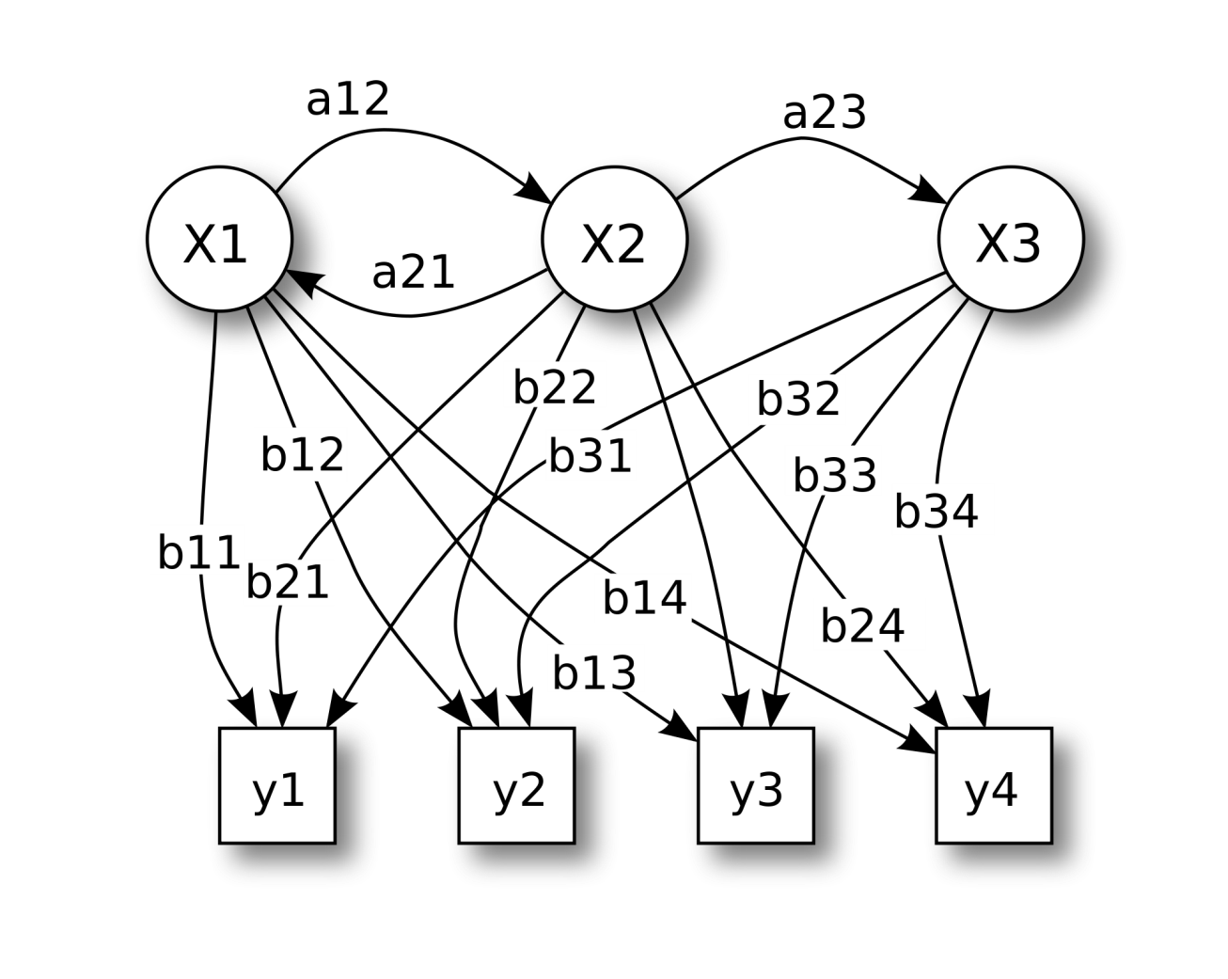
Request For Applications: Wx + H Enhanced
Notes:
Commerce is currently reviewing applications from our network of providers to provide phase one of the Wx + H advanced program.

Slide 12
Building Metrics to Evaluate the Program
Notes:
In order to demonstrate results of the program, Commerce is working to develop new reporting systems and relationships that will capture the long term impact of the new measures. Reporting at the end of the 2015-2017 will only provide a slice of the program’s potential.

Slide 13
Representative June Robinson, 38th Legislative District
June.Robinson@leg.wa.gov
(360) 786-7864
Michael Furze, Assistant Director
Energy Division, Washington State Department of Commerce
Michael.Furze@commerce.wa.gov
(360) 725-2950

