Slide 1
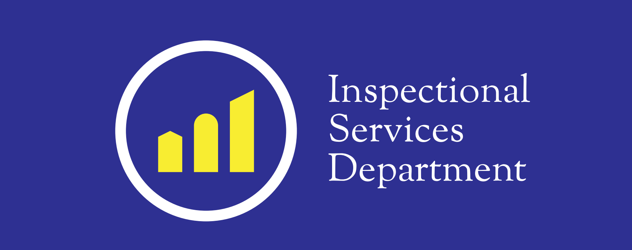
Proactive Rental Housing Registry and Inspection Ordinance
Notes:
Introduction: My name is Indira Alvarez, I am the Chief of Staff at Inspectional Services Department, City of Boston.
I’m here with Will Onuoha, Assistant Commissioner of the Housing Division and Evangeline Maxwell, Assistant Director of the Housing Division

Slide 2
Boston Housing at a Glance
Total housing units= 270,000
Total private rental units= 164,000
Estimates based on:
2010 Census
Assessing Records
Department of Neighborhood Development

Slide 3
Rental Ordinance (CBC 9-1.3)
Established 1984; Amended 2012 & 2014
Private units registered on an annual basis (2013)
Inspections conducted on a 5-year cycle (2014)
Funded by registration fees
Enforced through fines, prosecution, Chronic Offender designation
Notes:
In an effort to promote safe & healthy housing the COB amended the Rental Registration Ordinance (est. 1984) requiring the annual registration of all private rental units and inspection of all non-exempt rental units once every 5 years.
Inspections performed under Massachusetts
State Sanitary Code, 105 CMR 410, “minimum standards for human habitation.”

Slide 4
Management
Rental Program Team:
Director
Admin Assistant
2 Field Supervisors
10 Housing Inspectors
Additional administrative support staff

Slide 5
Registration Stats
As of 12/7/2015:
102,000 units
26,000 properties
17,000 property owners
21,000 units selected for inspection

Slide 6
Reporting Requirements
Annual reports required by City Council
Reporting to Cabinet on program performance
Outreach/ Education inquiries

Slide 7
Successes
Over 100,000 rental units registered with ISD
Data-driven performance management efforts and ongoing program analysis
Improved relationship between ISD and property owners
“Problem-Property” owners held accountable for their properties

Slide 8
End
BOSTON INSPECTIONAL SERVICES DEPARTMENT

