Slide 1
HEALTHY HOMES DATA
Using publicly available data to strengthen your HEALTHY HOMES program
Amanda Reddy, MS
National Center for Healthy Housing

Slide 2
What we’ll cover today:
Why (the right) data matters
Where to find data relevant to healthy homes at the national, state, and local levels.
Examples of how to use data to promote and sustain your programs.

Slide 3




Target resources
Monitor progress
Articulate need/value to potential funders
Assess the impact
Refine
the approach
Engage partners
Why it matters

Slide 4

Demographics
Risk factors associated with housing-related injury and illness:
  age and type of housing
  poverty
  geographical location
  age of residents
  Race/ethnicity of residents
Typical sources: U.S. Census (census tracts); county health rankings (county level for select measures); Environmental Public Health Tracking (county level for select measures)
Notes:
One place that national data can really shine is in identifying a need for healthy homes services and in figuring out where to target those services. While anyone can suffer from housing-related illness or injury, some common risk factors…
Maybe make a quick point about use of 1-, 3-, and 5-year estimates (effect on confidence interval for small areas).

Slide 5
 | Morrell Park/ Violetville CSA | Baltimore County | State of Maryland
Demographics
Total Population | 9,095 | 809,941 | 5,828,289
Age Distribution
0-17 years | 19.6% | 22.0% | 23.4%
18-24 years | 8.7% | 10.1% | 9.6%
25-44 years | 28.4% | 25.6% | 26.9%
45-64 years | 25.8% | 27.7% | 27.6%
65+ years | 17.6% | 14.6% | 12.5%
Race/Ethnicity
Black or African American | 18.8% | 26.8% | 30.0%
White | 73.3% | 65.4% | 61.1%
Asian | 2.4% | 5.2% | 5.8%
Hispanic or Latino | 4.3% | 4.4% | 8.4%
Income and Education
Median Household Income | $39,931 | $65,411 | $72,419
Less than $25,000 | 29.9% | 15.6% | 15.1%
Percent of Families in Poverty | 11.4% | 5.3% | 6.1%
Source: Baltimore Intermodal Health Impact Assessment, NCHH, 2013
Notes:
Nice use of appropriate comparsion (the specific neighborhood is put in context of the rest of the county and state). Use of red text to draw attention to specific characteristics of this neighborhood (older, poorer).

Slide 6
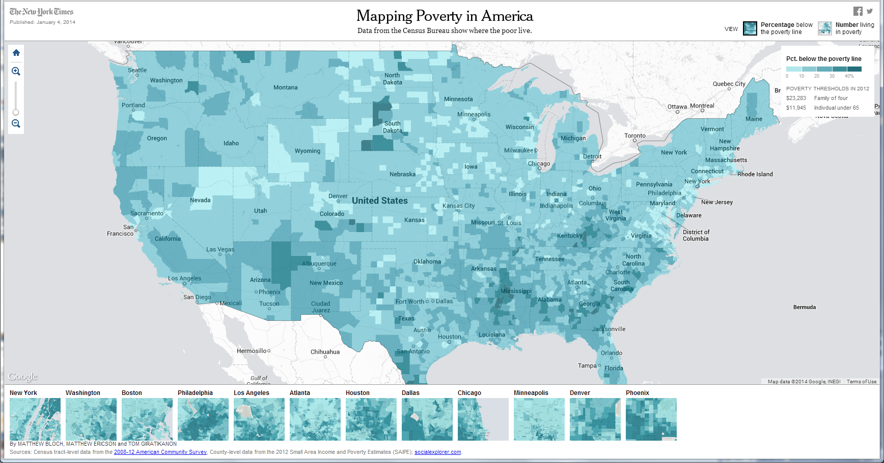
Notes:
Data from census available at census tract level. Lends itself well to mapping. Maps can be powerful tools, but scale matters. Poverty (darker blues) looks more rural at a national scale.

Slide 7
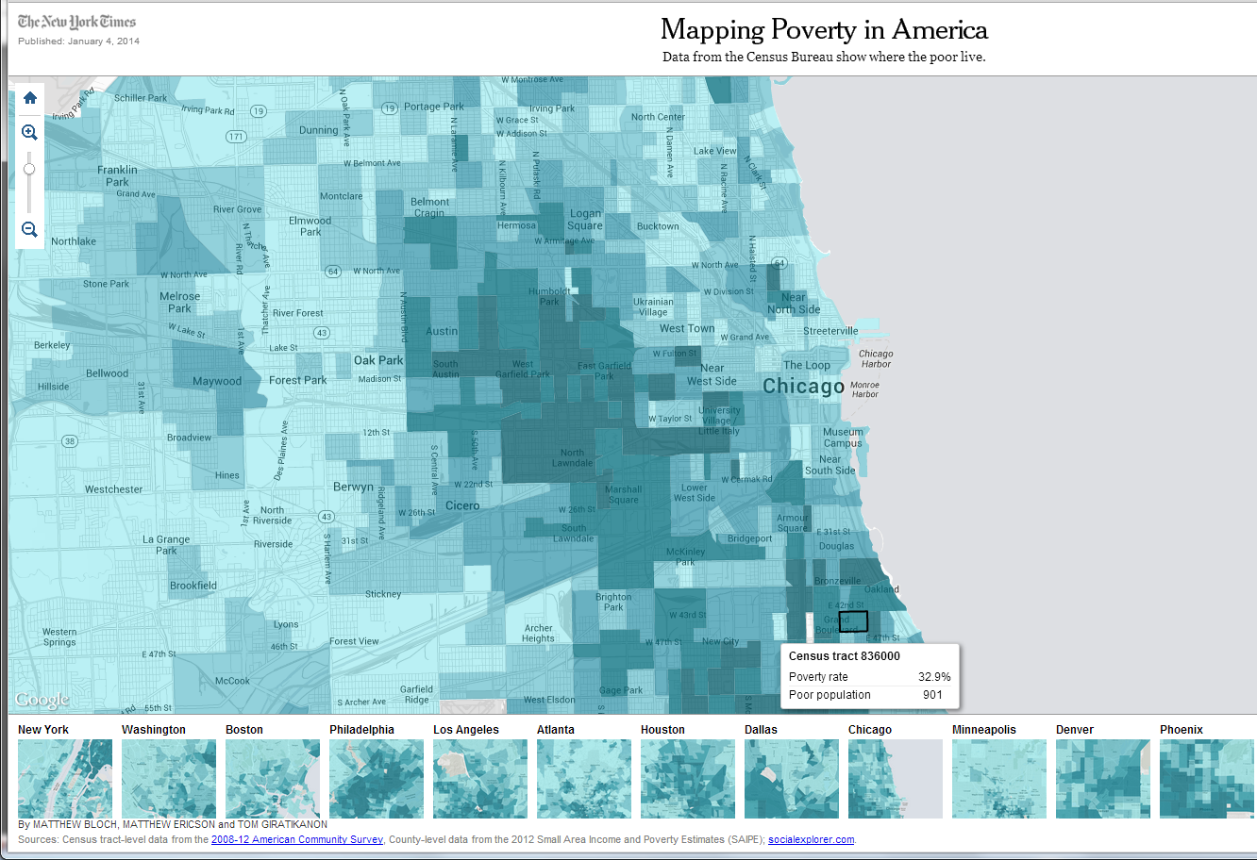
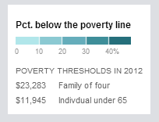
www.census.gov/geo/maps-data/data/tiger.html
Notes:
Looking at neighborhoods within Chicago, a different story emerges. We’ll hear a lot more about powerful use of maps in other presentations.

Slide 8
Housing Quality
May be difficult to find for all geographies, but some sources include:
  American Housing Survey
    www.census.gov/housing/ahs/
    State of Healthy Housing (www.nchh.org/Policy/2013StateofHealthyHousing.asp)
    www.huduser.org/portal/datasets/ahs.html
  American Community Survey
    www.census.gov/acs/www/
    http://factfinder2.census.gov/faces/nav/jsf/pages/index.xhtml
  Environmental Public Health Tracking
    http://ephtracking.cdc.gov/showHome.action
    Grantee sites
Notes:
Check links and add specific variables?

Slide 9
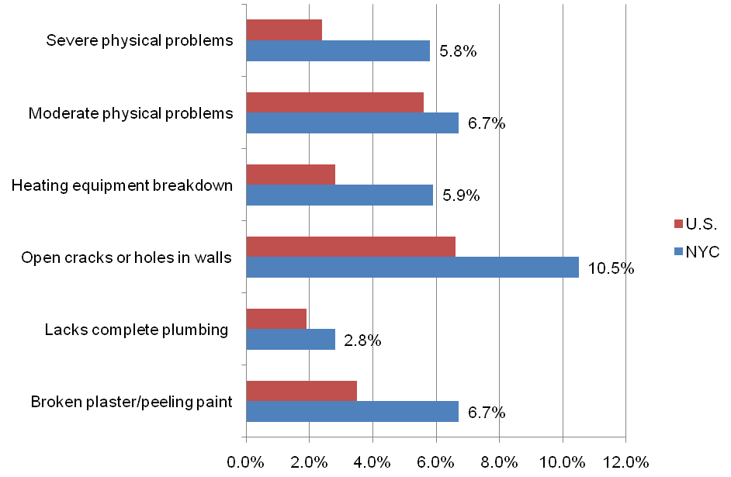
American Housing Survey
Notes:
Putting housing quality issues in NYC in a national context.

Slide 10
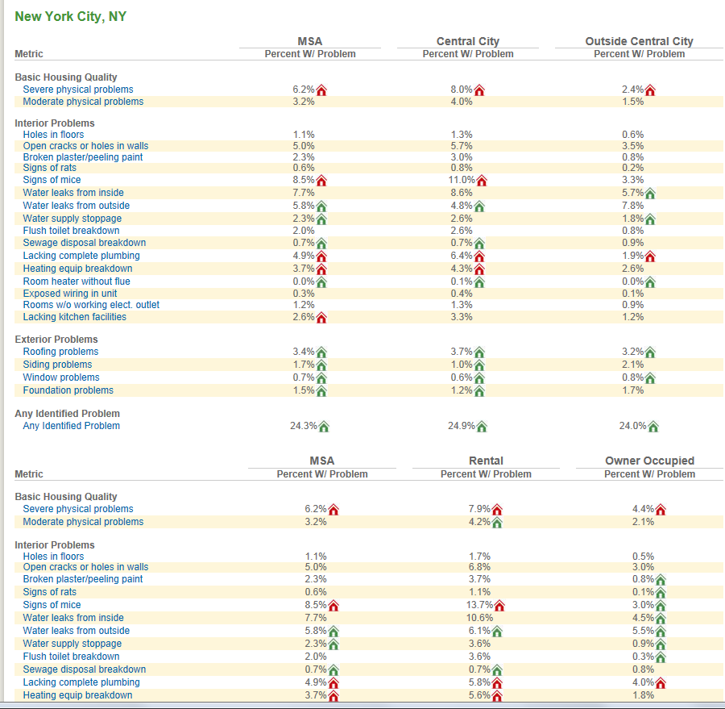
Source: State of Healthy Housing, NCHH, 2013
Notes:
Another application of American Housing Survey (and good data source in itself), NCHH’s State of Healthy Housing presents detailed housing quality information for MSAs and further breaks it down by Central City and Outside Central City.

Slide 11
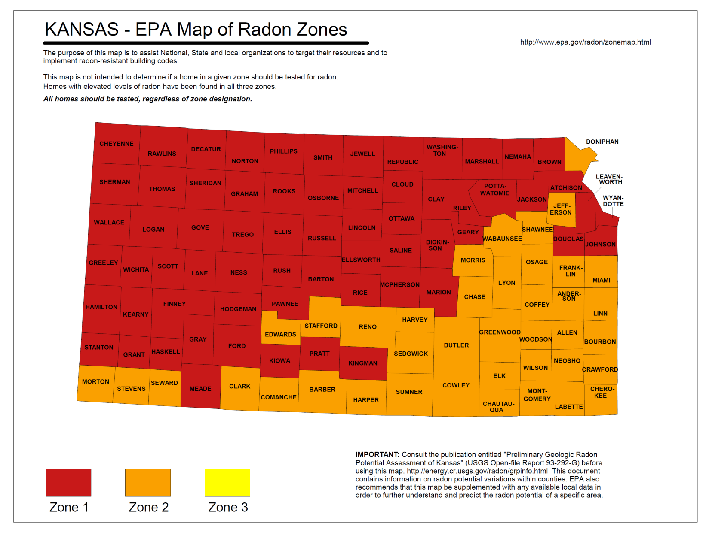
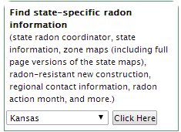
  EPA State Radon Maps www.epa.gov/radon/zonemap.html
Notes:
National data may exist for some specific housing hazards, like radon.
Navigate to state using drop-down menu shown in box at left.
Again, this is not data that would be used to track progress or for evaluating impact, but it could be used to articulate need/value…(and interestingly that can work the other way too…if someone…)

Slide 12
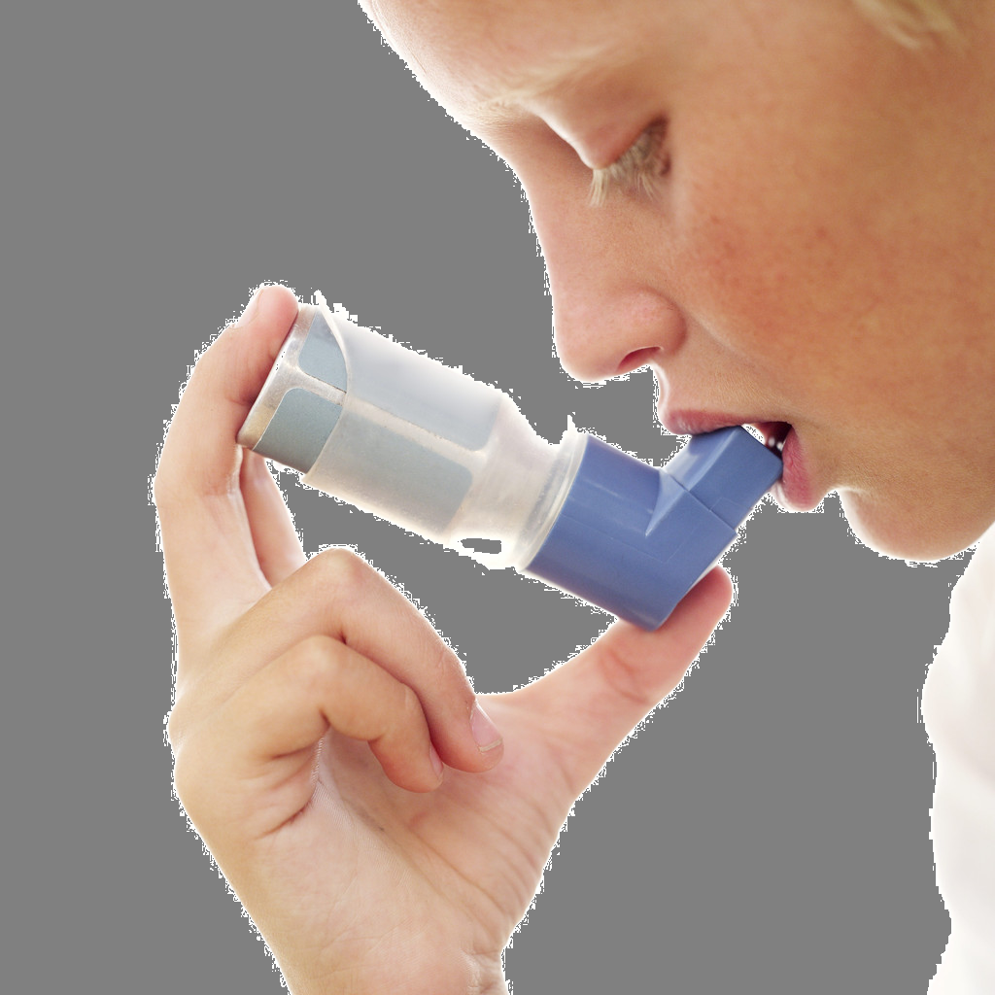
Health Outcomes
Asthma
Lead Poisoning
Injuries
Burns
Falls
Poisonings

Slide 13
Asthma
Behavioral Risk Factor Surveillance System (BRFSS), CDC
  www.cdc.gov/asthma/brfss/default.htm
Asthma Call-Back Survey (ACBS), CDC
  www.cdc.gov/asthma/ACBS.htm
Environmental Public Health Tracking, CDC
  http://ephtracking.cdc.gov/showHome.action
State Asthma Control Programs, Surveillance Data
  www.cdc.gov/asthma/contacts/default.htm
    www.health.ny.gov/statistics/ny_asthma/index.htm
    http://phpa.dhmh.maryland.gov/mch/SitePages/asthma_surv.aspx
Notes:
A lot of data for asthma comes from national telephone surveys and may not be available at refined levels.
Many states publish county or ZIP-code level data for events like ED visits, hospitalizations (link goes to page with links to program websites in funded states, navigate to data from there or find the right contact).
NOTE ABOUT ASTHMA: Prevalence vs. Morbidity (exacerbation vs. causation).

Slide 14
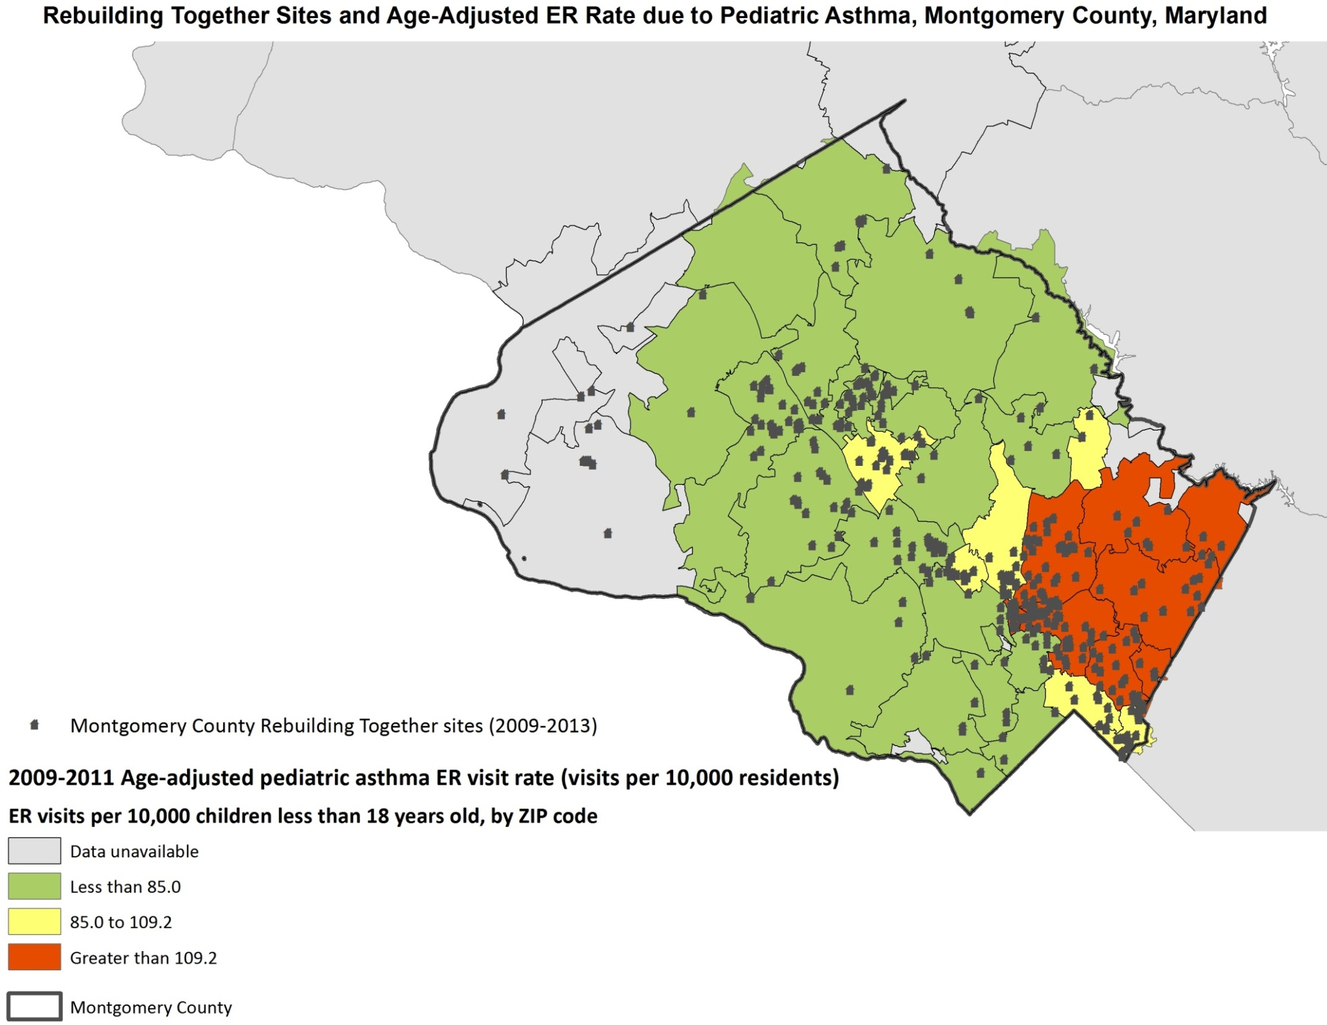
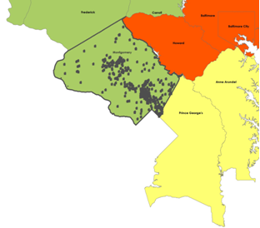
Notes:
Example of map made from state surveillance data published on a county portal (which we then took into GIS and overlaid with our service area).
Inset again underscores value of getting below county level…coarser geographic displays often mask place-based disparities.

Slide 15
Community Asthma Profile
 | Target Area | NYS | U.S.
Current asthma among adults | 11.8% | 9.8% | 8.6%
Current asthma among children ≤ 17 years | 13.9% | 7.4% | 8.4%
Taught early warning signs of worsening asthma | 94.9% | 67.6% | 60.0%
Have a prescription for long-term controller | 57.1% | 42.2% | 33.5%
Advised to modify school/work/home environment | --- | 44.4% | 50.9%
Asthma ED visit rate per 10,000 residents | 299.8 | 83.4 | 55.4
Asthma hospitalization rate per 10,000 residents | 47.3 | 20.5 | 15.2
Notes:
While things like medication and self-management might not immediately seem related to HH, this is an example where the clinical aspects of self-management are being addressed in this community at least as well as the rest of the state, yet the morbidity is much higher…may lead to argue for looking into the home environment.

Slide 16
Safety and Injuries
CDC Web-based Injury Statistics Query and Reporting System (WISQARS)
  www.cdc.gov/injury/wisqars/index.html
State departments of health
National Fire Protection Association
  www.nfpa.org
American Housing Survey (see previous link)
Environmental Public Health Tracking (see previous link)
BRFSS Preparedness data (selected states)
  www.cdc.gov/mmwr/preview/mmwrhtml/mm6136a1.htm
  State sites and surveillance reports
  www. citizencorps.fema.gov/cc/searchCert.do?submitByZip

Slide 17
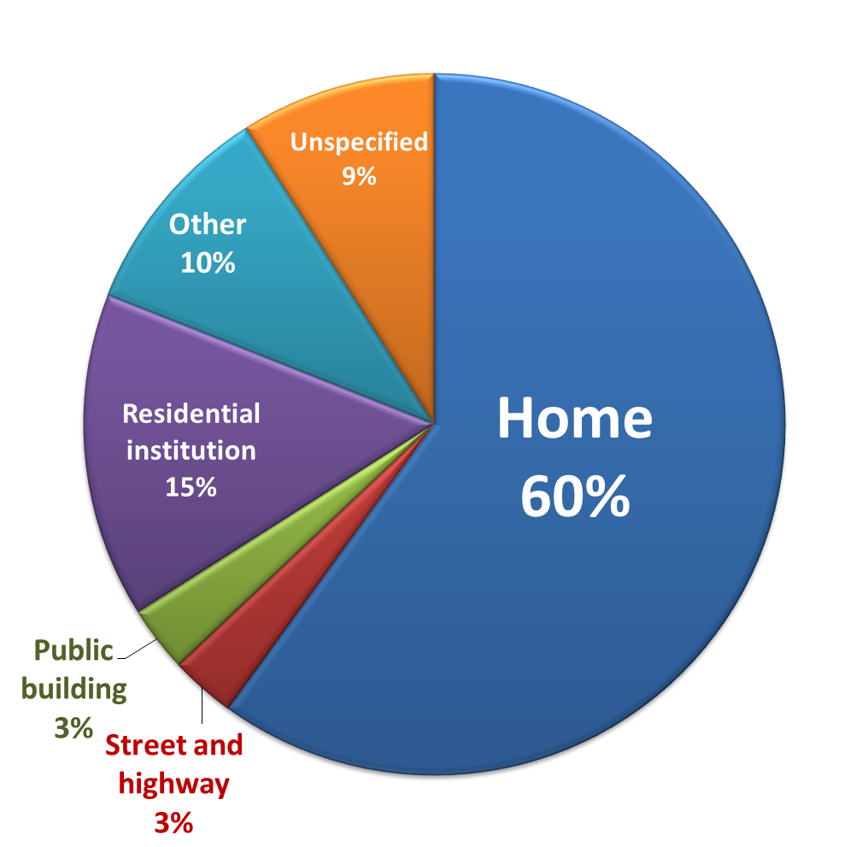
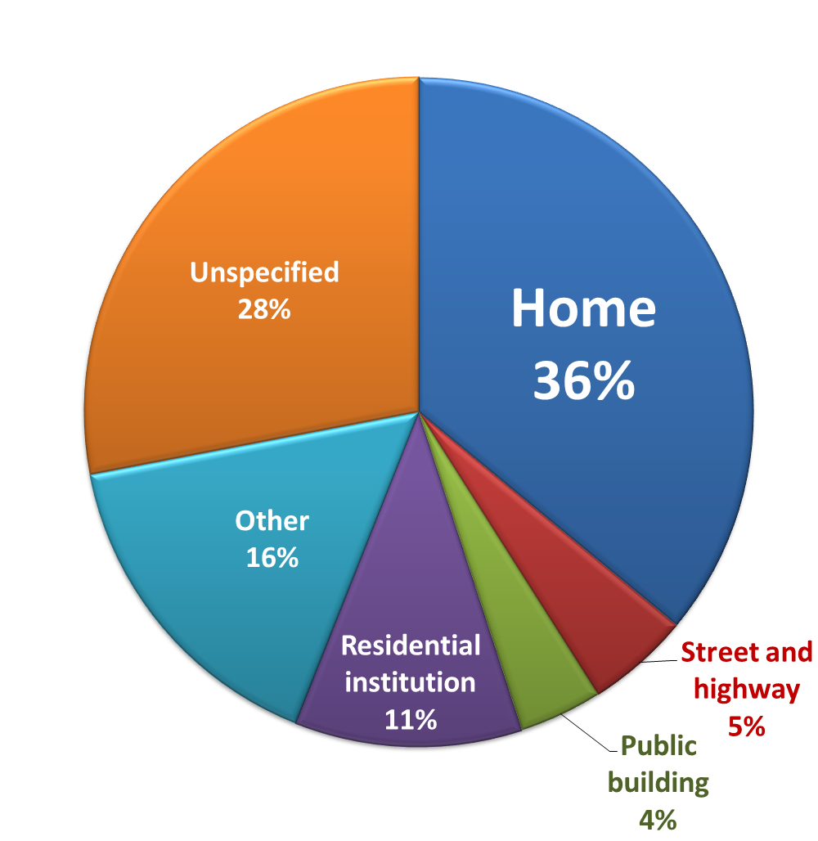
Safety and Injuries
Place of Fall, Ages 65+, New York State Residents, 2006-2008
Hospitalizations
ED Visits
Notes:
Example of using state level data to still convey importance of home environment.
2008 Unintentional Residential Fire/Flame Deaths and Rates per 100,000, New York and U.S.
2008 Unintentional Fall Deaths and Rates per 100,000, New York and U.S.
2008 Unintentional Fall Deaths and Rates per 100,000, Ages 65 to 85+, New York and U.S.

Slide 18
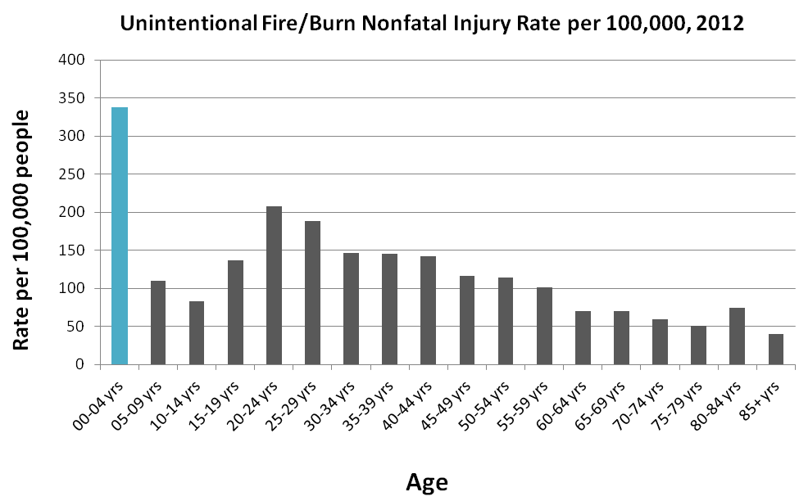
Safety and Injuries
Notes:
Data can be used to justify targeting of groups, not just locations.

Slide 19
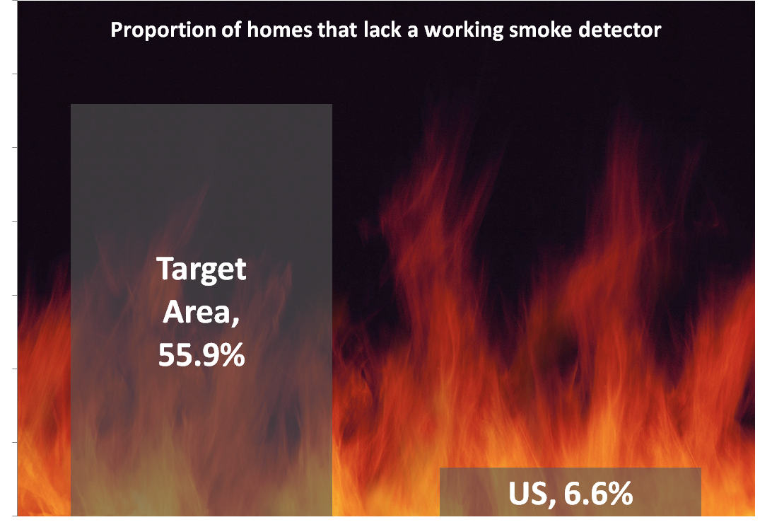
Fire safety
Notes:
Plug for making data presentation visually interesting…
National data from places like National Fire Protection Association, target area data is program data. Old data. May be different methods.

Slide 20

Lead Poisoning
CDC, Childhood Lead Poisoning Data, Statistics, and Surveillance
  www.cdc.gov/nceh/lead/data/index.htm
States may have maps and exportable data tables:
  Elevated BLL by county, year of test
  Lead screening by county, year of birth
  Age of housing
  Childhood poverty
Environmental Public Health Tracking (see previous link)

Slide 21
Healthcare Utilization
Hospitalizations
ED visits
Medication usage
Primary care and specialists
Typical sources: county health rankings (county level); Dartmouth Medical Atlas; state DOH surveillance and claims data

Slide 22
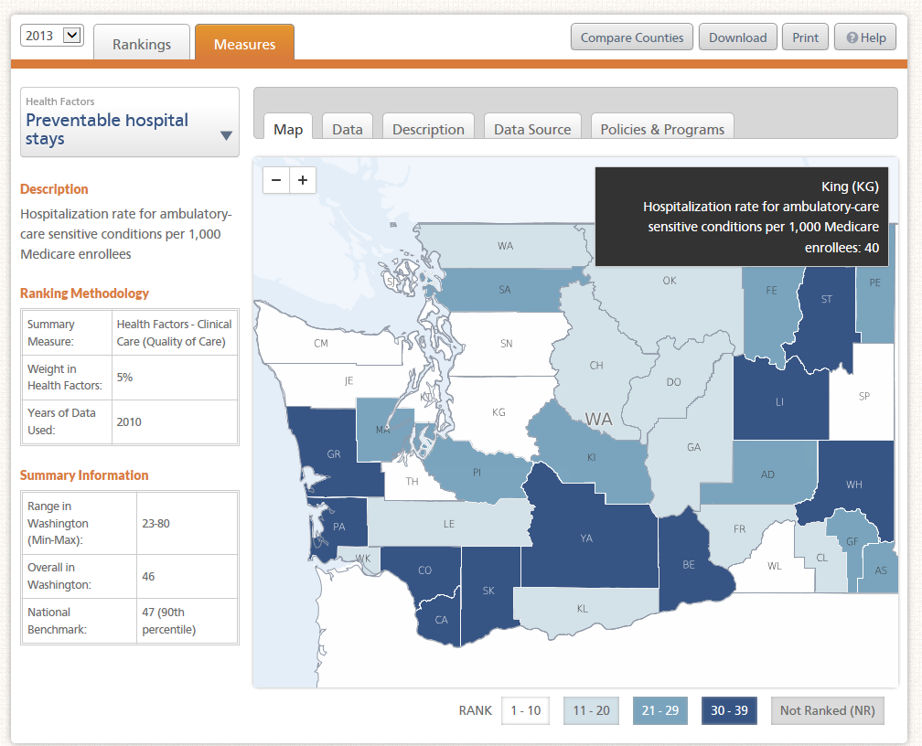
Notes:
Preventable hospital stays
Preventable hospital stays is measured as the hospital discharge rate for ambulatory care-sensitive conditions per 1,000 Medicare enrollees.
Reason for ranking
Hospitalization for diagnoses treatable in outpatient services suggests that the quality of care provided in the outpatient setting was less than ideal. The measure may also represent a tendency to overuse hospitals as a main source of care.
Measurement Strengths and Limitations
The rate of preventable hospital stays is often used to assess the effectiveness and accessibility of primary healthcare. [1,2] A study using data from the National Hospital Discharge Survey found that 12% of all hospitalizations in 1990 (3.1 million) were for potentially preventable conditions. [3]
A weakness of this measure is that it uses Medicare claims data, which limits the population evaluated to mostly individuals age 65 and older. This measure, therefore, may potentially miss trends and disparities among younger age groups.
This measure could be classified as both a quality and access measure, as some literature describes hospitalization rates for ambulatory care-sensitive conditions primarily as a proxy for access to primary healthcare. [4]

Slide 23
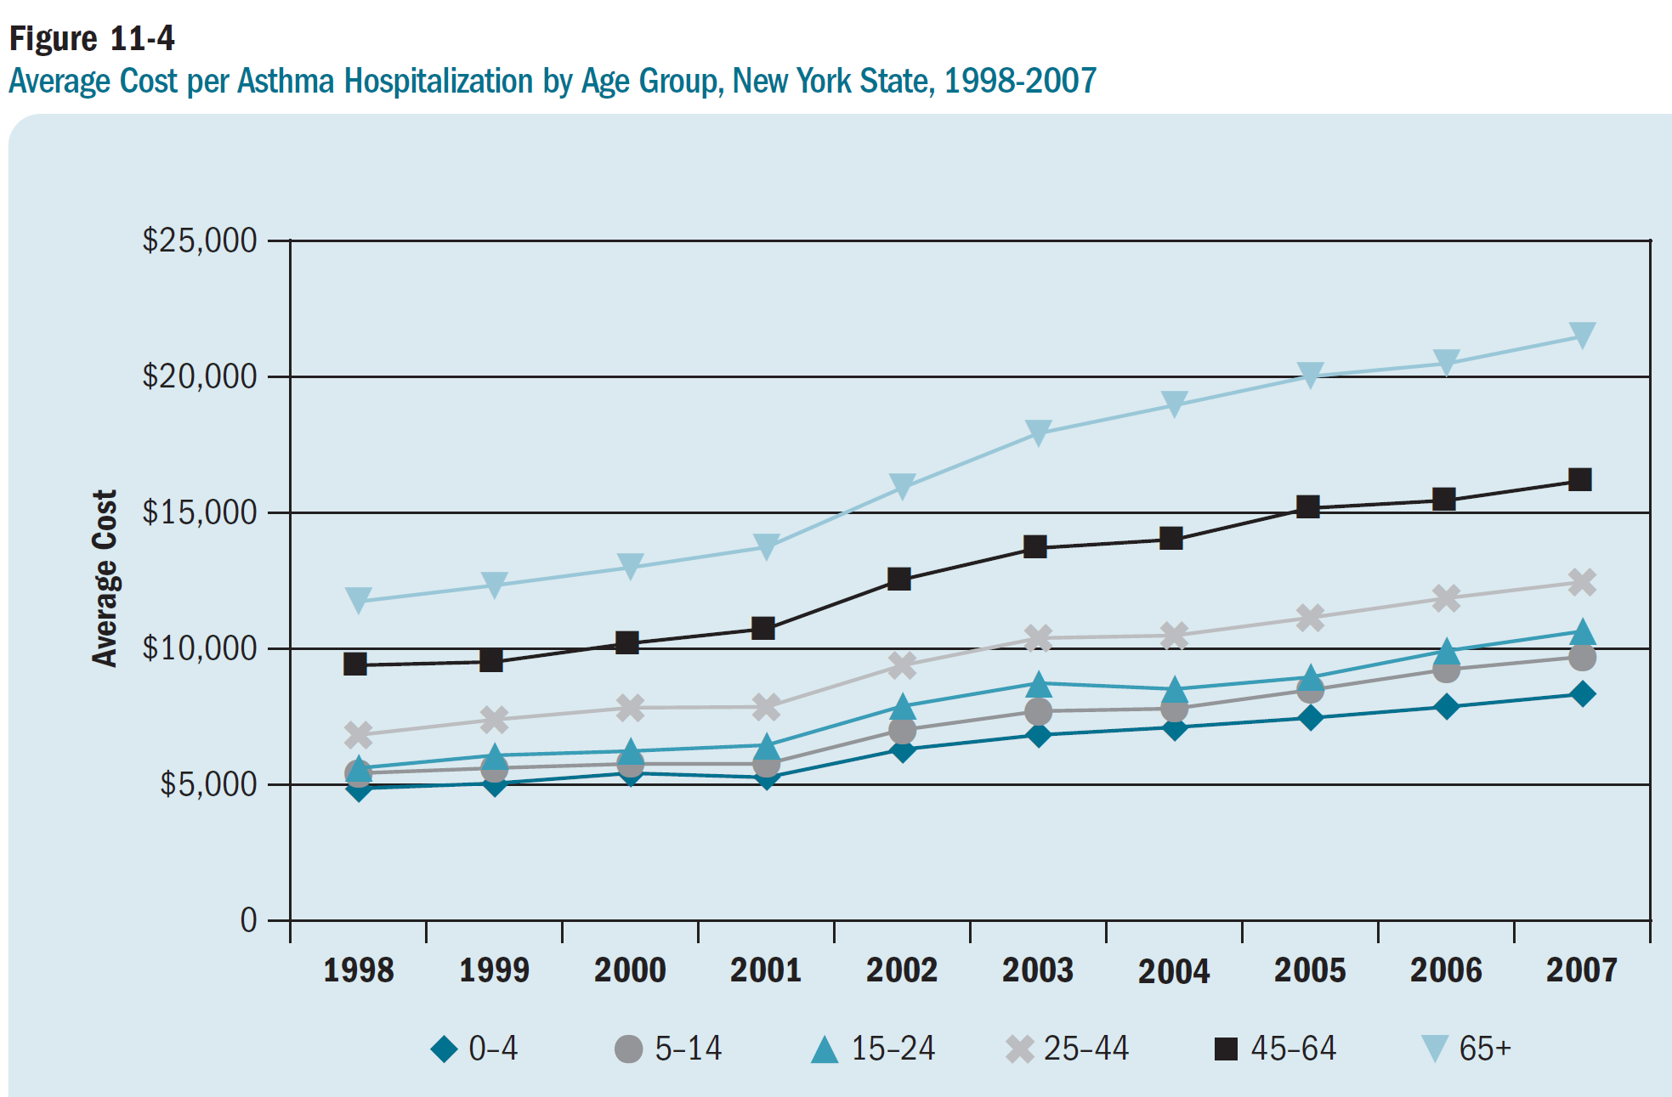
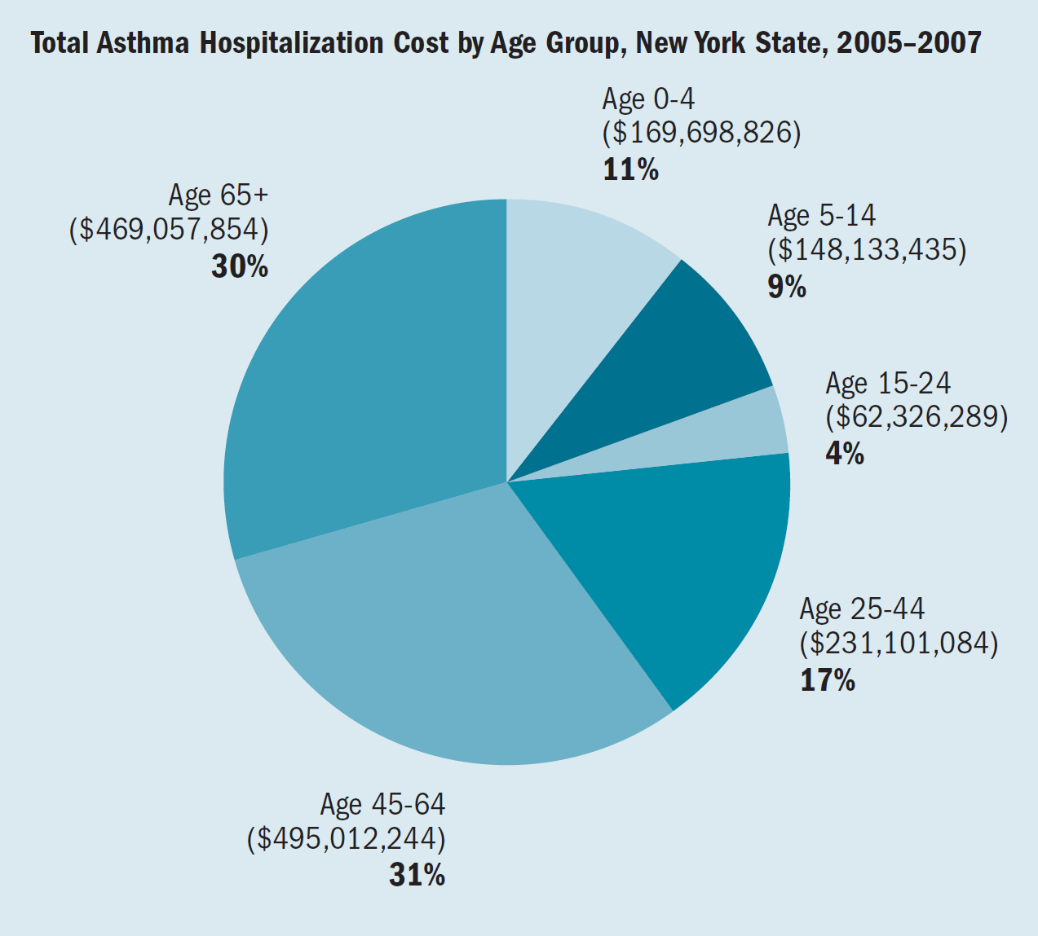

Slide 24
Other sources to consider
911 data
Hospitals/health plans
Local or state health department, other agencies
County data portals

Slide 25
General tips
Be deliberate and thoughtful about your use of data
  Think about the appropriate scale/geography
  Avoid common mistakes (e.g., averaging percentages)
  Use data with intention
Use validated tools when possible
  Saves time, avoids known problems, allows for comparison
Consider your audience (What will they find most compelling? How do they like to receive information? Can you make it more visually appealing?)
Pair quantitative data with qualitative stories
Packaging matters!
Technical support available – Just ask!
  State DOH, academic partners, NCHH, other local or regional partners

Slide 26
For more information:
Amanda Reddy, MS
National Center for Healthy Housing
areddy@nchh.org

