Slide 1

The California Healthy Housing Coalition
SB 655:
California’s New Mold Law

Slide 2
California Healthy Housing Coalition
Mission:
  To provide leadership to promote healthy, safe, energy efficient, and affordable housing for all residents in California, with a particular focus on the needs of low income communities and communities of color.
Goals and Principles:
  Provide resources, expertise, and advocacy for statewide policies to promote and protect healthy housing
  Particular focus on equity (low income and communities of color, children, the elderly and other vulnerable populations)
Notes:
Formed in 2010
A diverse, multi-sector coalition

Slide 3
Code Enforcement Workgroup
Focus: Substandard housing conditions
Priorities
  Pest infestations and IPM
    Bills passed in 2013, 2014, and 2015
  Mold
    Bill passed in 2015
Notes:
Small, achievable goals build capacity and political capital. Stepping stones to more complex and challenging policies (eg – mold)

Slide 4
SB 655
Signed by Governor Brown
October 9, 2015
How did we do it?
Notes:
This journey begins in 2001 after the legislature influenced by testimonies from TV Tonight Show Co Host Ed McMann and Environmental Activist Erin Brockovich passed what became known as the Toxic Mold Protection Act . Side note, Larry Brooks also provided data and testimonies but only to CNN, Senator Ortiz and her staff as his time to appear at a legislative hearing was bumped by the appearance of Ms. Brockovich.

Slide 5
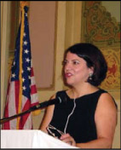
The Toxic Mold Protection Act of 2001
Senator Deborah Ortiz
First piece of legislation in the nation to acknowledge hazards of toxic mold in buildings However no appropriation of funding.
Directed Dept of Health Services to determine feasibility of identifying permissible exposure limits (PELs)
2005 DHS reported it would be difficult to establish PELs DHS did determine that to protect human health, indoor dampness, water intrusion, and fungal growth must be prevented.
Notes:
The Toxic Mold Protection Act of 2001 was enacted to address increasing concerns regarding health effects from exposure to indoor molds and to provide Californians with guidelines or standards for the safe and effective removal of molds from buildings. This statute directs the California Department of Health Services (DHS) to determine the feasibility of identifying permissible exposure limits (PELs) for indoor molds, as well as to convene a stakeholder task force to consult with DHS in developing enforceable standards and voluntary guidelines to prevent health conditions that may arise from exposure to or remediation of damp or moldy indoor environments.
June 2005, determined that it would be very difficult to establish a PEL for mold in buildings because of inadequate toxicity data, the wide variety of potentially harmful molds and their toxins, and other factors that affect indoor air quality. DHS did determine that to protect human health, indoor dampness, water intrusion, and fungal growth must be prevented

Slide 6
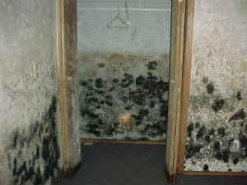
Impacts of DHS Report
Code Enforcement Officers
Building Inspectors
Environmental Health Specialists
Property Managers
Landlords
Notes:
Reluctance by regulatory personnel and rental industry to address mold except when clear evidence of water intrusion such as roof leaks and broken plumbing.

Slide 7

CHHC Code Enforcement Working Group
Review of Texas and New York Mold Laws
Meetings with subject matter experts in fields of environmental health, building construction, enforcement, landlord/tenant law etc.
Notes:
Conclusion: Regulators do not have to know PELs to identify mold as a substandard housing condition that can affect the health/safety of the occupant. Nor do they need to see the source of water if they can see the mold

Slide 8



Legislative Champions
Author: Senator Holly Mitchell (D – Los Angels)
Sponsors:
Notes:
Coalition ID’d problem – inconsistent enforcement across state due to a lack of clarity in state code
CHHC developed and proposed a policy clearing up ambiguity in code in relation to mold to lawmakers
Sen Mitchell introduced the bill
CHHC members lead the advocacy/lobbying efforts and efforts to engage CHHC members in the process

Slide 9

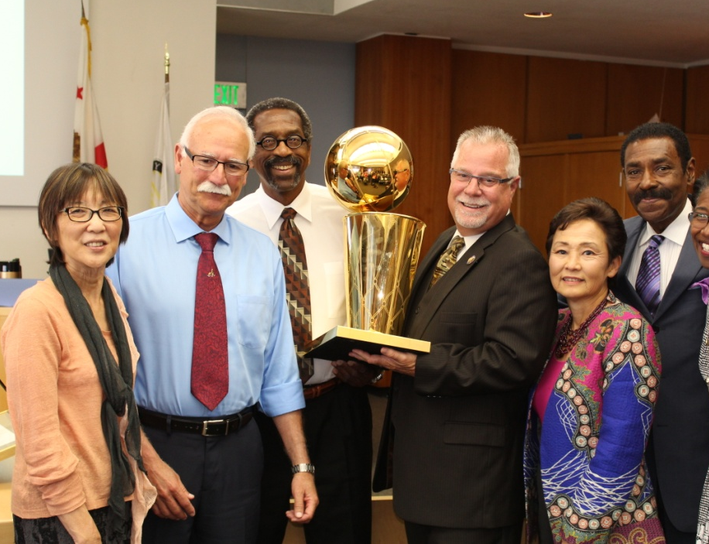






Building up the Will to make a Change!
Notes:
Start with winning an NBA Championship and gaining the support of Alameda County Board of Supervisors LOL! Truthfully the Board of Sups was a big win because it got their Legislative Advocate in the State Capitol on board with the legislation so he could begin to garner support. Plus the ACHHD JPA is made up of City Council members from four major cities in our county. Getting Tenant Rights Groups working with Landlord Groups
Support
California Association of Code Enforcement
Officers (Sponsor)
Regional Asthma Management and
Prevention (Sponsor)
Alameda County Board of Supervisors
Alameda County Healthy Homes
Department Joint Powers Authority
American Lung Association – California
Breathe California –Golden Gate
California Pan Ethnic Health Network
Cardino Inc.
Center for California Homeowner
Association Law
City of Emeryville
City of Fremont
Causa Justa:Just Cause
Coalition for Economic Survival
Community Action to Fight Asthma
East Bay Community Law Center
Esperanza Community Housing Association
Healthy Homes Collaborative
Housing California
Inquilinos Unidos
Kern County Asthma Coalition
Koreatown Immigrant Workers Alliance
Legal Aid of Marin
Long Beach Alliance for Children with
Asthma
Oakland Tenant’s Union
Pacoima Beautiful
Physicians for Social Responsibility – Los
Angeles
Public Health Institute
St. John’s Well Child & Family Center
San Francisco Asthma Task Force
Society for Allergy Friendly Environmental
Gardening
Sonoma County Asthma Coalition
Western Center on Law and Poverty
West Oakland Environmental Indicators
Project
Wilma Chan, District 3 Supervisor,
Alameda County Board of Supervisors

Slide 10
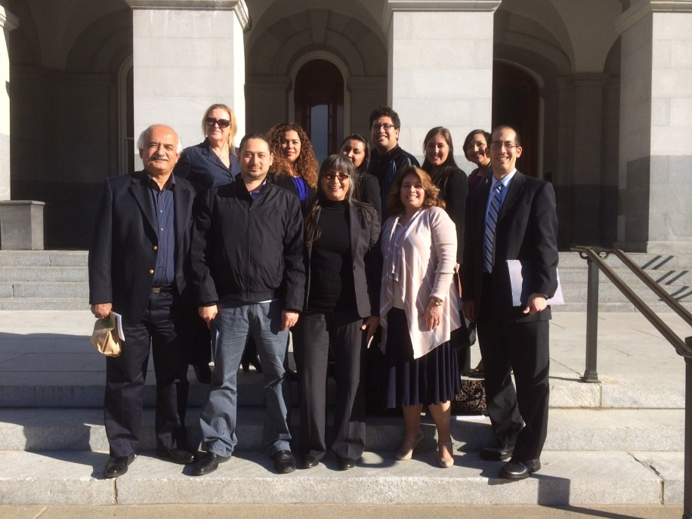
Outpacing Opposition
Very strong opposition from landlords
Mythbusters
Answering calls to action
Notes:
Partners were helpful. In contrast…had to face stiff opposition.

Slide 11
SB 655: California’s New Mold Law
Establishes “visual mold” as a substandard housing condition
  Clarifies that “minor mold found on surfaces that can accumulate moisture as part of their properly functioning and intended use” is not a substandard condition.
Reaffirms landlord’s civil liability
  A landlord must know about the problem and be given reasonable time to make repairs
  A tenant must allow access to the unit
  The mold problem cannot be “substantially caused” by the tenant
Notes:
Gives authority to health and code enforcement officers to require landlords to remediate mold
Meaning easily cleanable mold commonly found around sinks, showers, and bathtubs is not substandard unless it is the result of a leak or other defect.
Consistent with existing liability for other substandard conditions

Slide 12

Implementation Plan
Begin to offer workshops locally and throughout the State
Seek to have presentation at the CACEO Annual Conference
Go National!
Notes:
CACEO, California Dept of Public Health and ACCEN will be leading the way as well as the Alameda County Healthy Homes Dept through the Alliance and a effort to establish a Mold Response Unit in the unincorporated area as well as holding a local Mold workshop for community members and property owners to explain SB 655 and to provide information on best practices to prevent or safely abate mold in the home.

