Slide 1

CALIFORNIA HEALTHY HOUSING COALITION
CA Senate Bill 488

Slide 2

The Problem
CA Substandard Housing Code only allows a Health Officer to:
determine a pest infestation
determine if adequate garbage and rubbish storage and removal facilities are present
In CA, most Cities do not have Health Officers so pest infestation enforcement was not being performed in 40% of jurisdictions

Slide 3
The Solution!
CHHC Code Enforcement Work Group set as priority in 2011 to modify CA Health & Safety Code 17920.10
Modification would allow local code enforcement officers to determine when there are pest and vermin infestations, and cite for inadequate garbage storage and removal.

Slide 4
Legislative Process
Identified Author: Senator Hueso
Identified primary sponsors:
  Regional Asthma Management and Prevention Program
  CA Pan-Ethnic Health Network
  CA Association of Code Enforcement Officers
  Senate: 42-0
  Assembly: 74-0
  Governor Signed: August 12, 2013

Slide 5
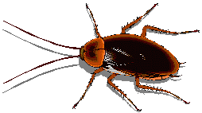
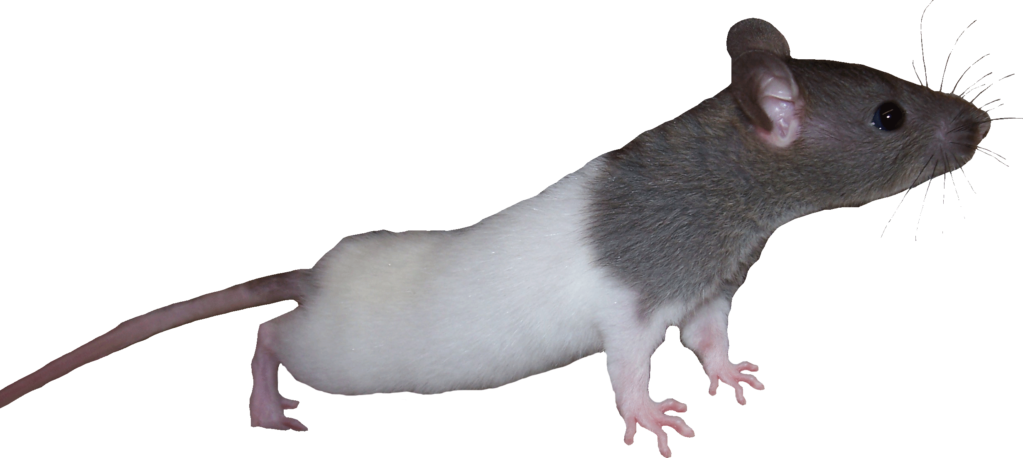
ANY QUESTIONS?
CHHC Code Enforcement Working Group
Co-Chairs: Brandon Kitawaga & Alan Johanns
To find out more information about the bill, go to the CHHC website: http://www.cahealthyhousing.org/

